Slide 1
ECE 3436 Microprocessor Systems Notes 4b: Condition Codes I
Ph.D. Jianfeng Zheng
Dept. ECE, Univ. of Houston
Email: jzheng4@central.uh.edu
Feb 12, 2026
Adapted from notes by Dr. Diana De La Rosa-Pohl

Slide 2
Today’s agenda in ECE 3436
Review 2’s complement numbers
Predict condition flag values
Observe conditions flags during program execution

Slide 3
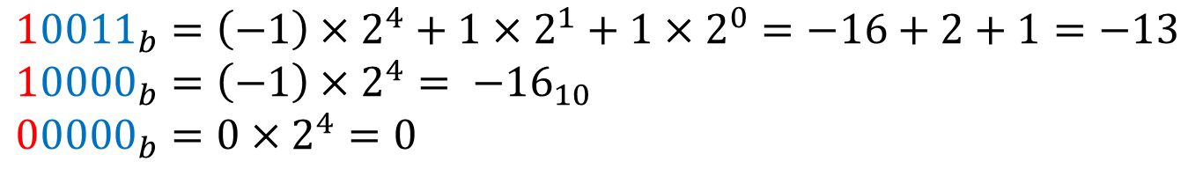






2’s Complement Review
Two’s complement
Add one extra sign bit and flip all bits
Add one
$${{13}_{10}=01101}_{b}$$
$${{+0}_{10}=00000}_{b}$$
$${{−13}_{10}=10010}_{b}$$
1’s
$${{−0}_{10}=11111}_{b}$$
1’s
$${{−13}_{10}=10011}_{b}$$
2’s
$${{−0}_{10}=00000}_{b}$$
2’s
$${10011}_{b}=\left(−1\right)×2^{4}+1×2^{1}+1×2^{0}=−16+2+1=−13$$
$${10000}_{b}{=\left(−1\right)×2^{4}= −16}_{10}$$
$${00000}_{b}=0×2^{4}=0$$

Slide 4
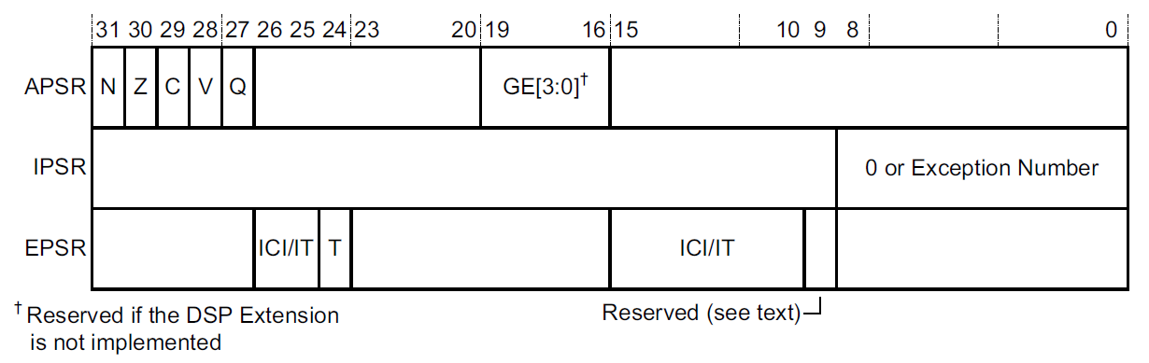
Condition Flags
The Program Status Register (PSR) is a 32-bit register.
Application Program Register, APSR (application level/unprivileged Software)
Interrupt Program Status Register, IPSR (holds exception number)
Execution Program Status Register, EPSR (Holds execution state bits)

Slide 5
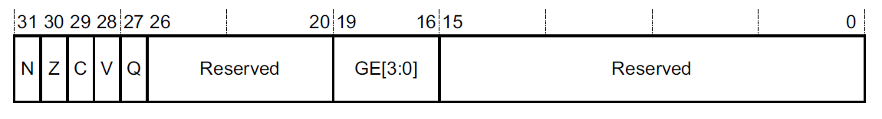
Condition Flags
FLAGS
N, bit[31] Negative condition code flag. If the result is regarded as a two’s complement signed integer, then N==1 if the result is negative and N==0 if it is positive or zero.
Z, bit[30] Zero condition code flag. Set to 1 if the result of the instruction is zero, and to 0 otherwise.
C, bit[29] Carry condition code flag. Set to 1 if the instruction results in a carry condition.
V, bit[28] Overflow condition code flag. Set to 1 if the instruction results in an overflow condition.

Slide 6
Condition Flags
Bit | Name | Meaning if set (1)
N | negative | Result is negative
Z | zero | Result is zero
V | overflow | Signed overflow
C | carry | Unsigned addition overflow
T | Thumb mode | Microprocessor is in Thumb mode
C flag
Set (1) after an unsigned addition if the answer is wrong
Clear (0) after an unsigned subtraction if the answer is wrong
V flag
Set (1) after a signed addition or subtraction if the answer is wrong

Slide 7
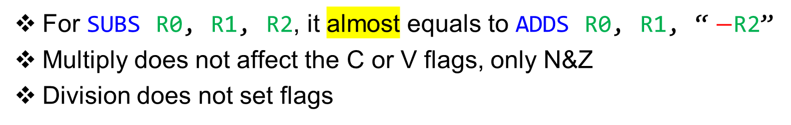
Arithmetic gone wrong
Carry flag warnings
Overflow flag warnings
Carry bit SET
Unsigned addition → Wrong
Carry bit CLEAR
Unsigned subtraction → Wrong
Overflow bit SET
Signed addition → Wrong
Signed subtraction → Wrong
For SUBS R0, R1, R2, it almost equals to ADDS R0, R1, “ $−$R2”
Multiply does not affect the C or V flags, only N&Z
Division does not set flags

Slide 8
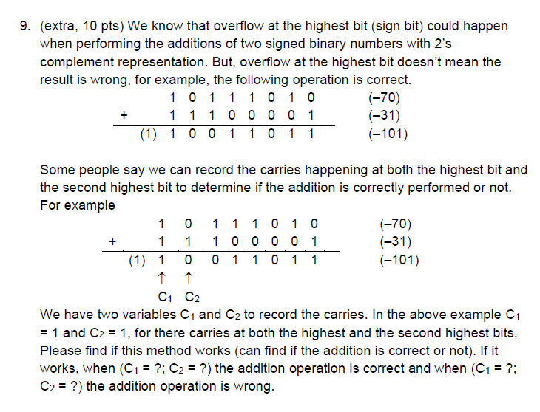
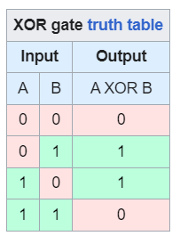

C flag and V flag
Define:
Co: Carry out at MSB (C1)
Ci: Carry in at MSB (C2)
Then:
C = Co
V = XOR (Ci, Co)
$$XOR\left(A,B\right)=\left(A∙\overline{B}\right)+\left(\overline{A}∙B\right)$$

Slide 9

C flag and V flag
Co, carry out
Ci, carry in
Define:
Co: Carry out at MSB
Ci: Carry in at MSB
$$XOR\left(A,B\right)=\left(A∙\overline{B}\right)+\left(\overline{A}∙B\right)$$
0 1 0 0 0 0 0 1
+ 1 1 0 1 0 0 1 1
1 0 0 0 1 0 1 0 0
Then:
C = Co
V = XOR (Ci, Co)
In the shown example, Ci = 1, Co =1, we get C = 1 and V = 0.

Slide 10
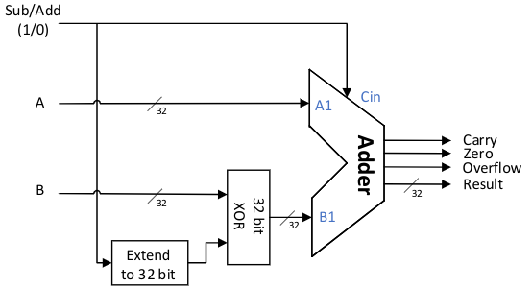
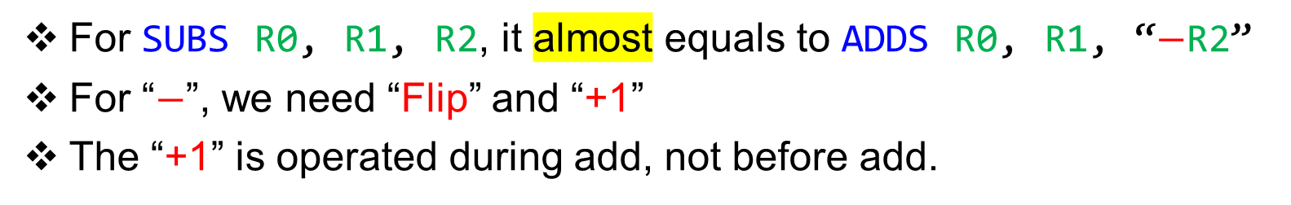
C flag and V flag (Arithmetic Logic Unit)
Check the corner case
MOV R1, #0
MOV R2, #0
SUBS R0, R1, R2
For SUBS R0, R1, R2, it almost equals to ADDS R0, R1, “$−$R2”
For “$−$”, we need “Flip” and “+1”
The “+1” is operated during add, not before add.

Slide 11
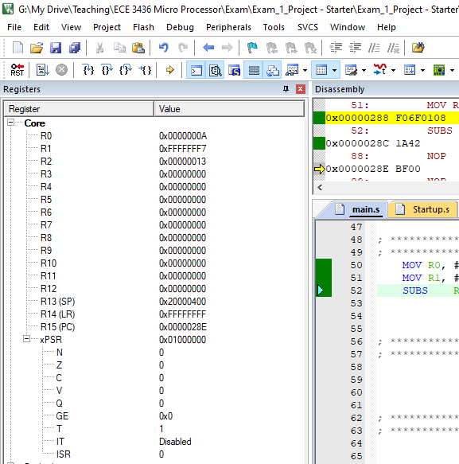
How do you know if flags will be updated
Check the FLAGs in debug mode, and
ARM®v7-M Architecture Reference Manual
Cortex-M4 Technical Reference Manual

Slide 12
EX. 1: Zero (Z) Flag
Ex: 0x10 + 0x01
Answer: ________
Is the answer zero?
No → Z = 0
Yes → Z = 1

Slide 13
EX. 2: Zero (Z) Flag
Ex: 0x00 + 0x00
Answer: ________
Is the answer zero?
No → Z = 0
Yes → Z = 1

Slide 14
Check
0xA0A0.A0A0 + 0x0505.0505
Is the answer zero?
Z = 0 or 1
Is the answer negative?
Does the calculations produce a carry?
Is the answer correct?
0xFFFF.FFFF + 0x0000.0001
Is the answer zero?
Z = 0 or 1
Is the answer negative?
Does the calculations produce a carry?
Is the answer correct?

Slide 15
EX. 3: Negative (N) Flag
Ex: 0x01 + 0x01
Answer: ________
Is the answer negative? How do you know?
No → N = 0
Yes → N = 1

Slide 16
EX. 4: Negative (N) Flag
Ex: 0x0000.0000 + 0xFFFF.FFFF
Answer: ________
Is the answer negative?
No → N = 0
Yes → N = 1

Slide 17
Check
0x1234.ABCD − 0x1234.0000
Is the answer negative
Z = 0 or 1
Is the answer zero?
Does the calculations produce a carry?
Is the answer correct?
0xFFFF.FFFF − 0xF000.0001
Is the answer negative?
N = 0 or 1
Is the answer zero?
Does the calculations produce a carry?
Is the answer correct?

Slide 18
EX. 5: Carry (C) & Overflow (V) Flags
Ex: 0x0000.0010 + 0x0000.0001
Answer: ________
Unsigned Numbers:
16 + 1 = 7
The answer is correct/incorrect?
Signed Numbers:
16 + 1 = 7
The answer is correct/incorrect?

Slide 19
EX. 6: Carry (C) & Overflow (V) Flags
Ex: 0x8000.0000 + 0x0000.0001
Answer: ________
Unsigned Numbers:
2,147,483,648 + 1 = 2,147,483,649
The answer is correct/incorrect?
Signed Numbers:
−2,147,483,648 + 1 = − 2,147,483,647
The answer is correct/incorrect?

Slide 20
EX. 7: Carry (C) & Overflow (V) Flags
Ex: 0xFFFF.FFFF + 0x0000.0001
Answer: ________
Unsigned Numbers:
4,294,967,295 + 1 =0
The answer is correct/incorrect?
Signed Numbers:
−1 + 1 = 0
The answer is correct/incorrect?

Slide 21
EX. 8: Carry (C) & Overflow (V) Flags
Ex: 0x7FFF.FFFF + 0x7FFF.FFFF
Answer: ________
Unsigned Numbers:
2,147,483,647 + 2,147,483,647 = 4,294,967,294
The answer is correct/incorrect?
Signed Numbers:
2,147,483,647 + 2,147,483,647 =
−2
The answer is correct/incorrect?

Slide 22
EX. 9: Carry (C) & Overflow (V) Flags
Ex: 0x8000.0000 + 0x8000.0000
Answer: ________
Unsigned Numbers:
2,147,483,648 + 2,147,483,648 = 0
The answer is correct/incorrect?
Signed Numbers:
− 2,147,483,647 + − 2,147,483,647 = 0
The answer is correct/incorrect?

Slide 23
Now You Try
0x000.0001 + 0x0000.0001
Is the answer zero?
Z = 0 or 1
Is the answer negative?
N = 0 or 1
Is there a carry
C = 0 or 1
Is the answer correct
V = 0 or 1
0x0000.0001 − 0x0000.0001
Is the answer zero?
Z = 0 or 1
Is the answer negative?
N = 0 or 1
Is there a carry
C = 0 or 1
Is the answer correct
V = 0 or 1

Slide 24
Now You Try
0x6666.6666 / 0x0000.0002
Is the answer zero?
Z = 0 or 1
Is the answer negative?
N = 0 or 1
Is there a carry
C = 0 or 1
Is the answer correct
V = 0 or 1
0x8000.0000 * 0x0000.0002
Is the answer zero?
Z = 0 or 1
Is the answer negative?
N = 0 or 1
Is there a carry
C = 0 or 1
Is the answer correct
V = 0 or 1

